Slide 1
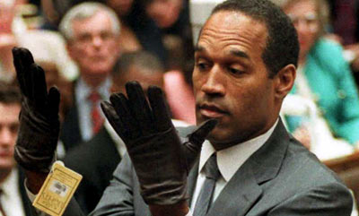
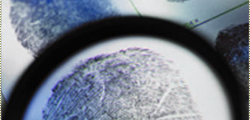
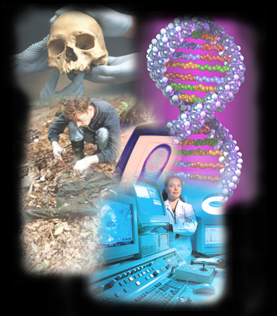
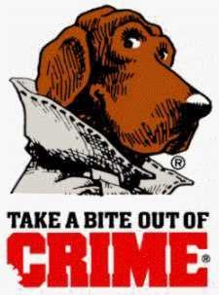
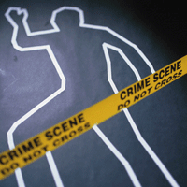
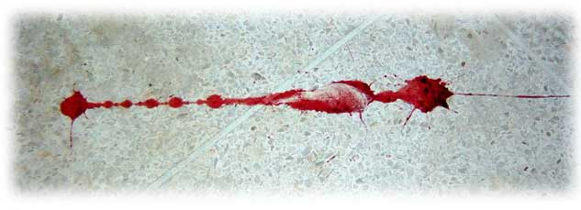
Forensic Science
Introduction

Slide 2
History of
Forensic Science

Slide 3
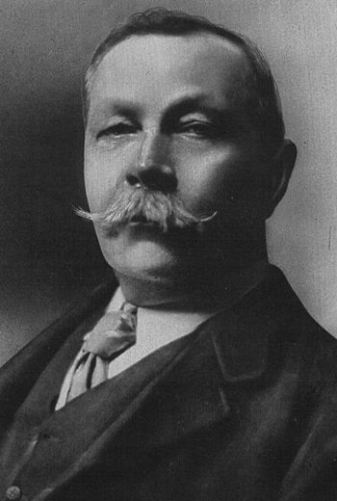
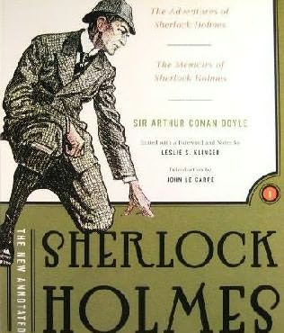

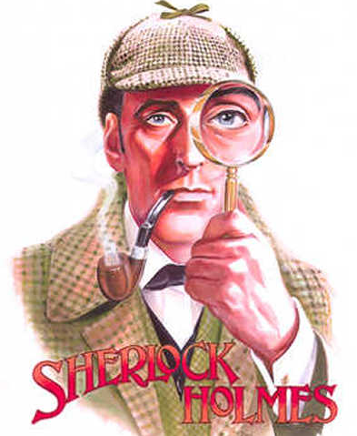
A Brief History of Forensics
Sir Arthur Conan Doyle –
19th century (1800’s)
author of Sherlock Holmes
First to apply serology,
ballistics, fingerprinting,
document analysis to
investigations

Slide 4
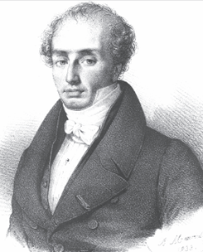
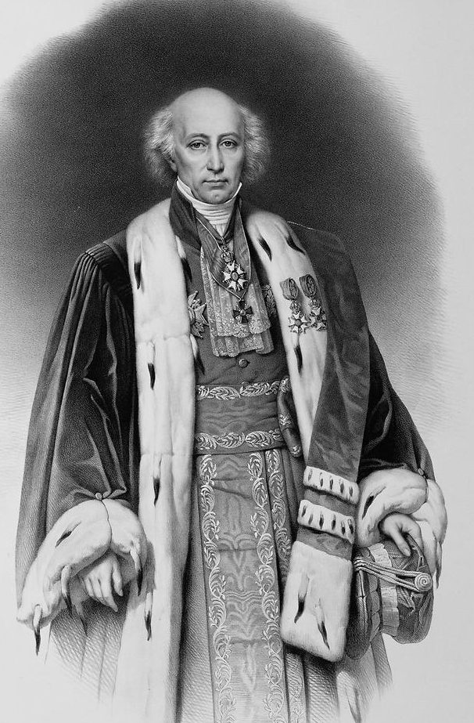
Mathieu Orfila (1787-1853)
“father of forensic toxicology”
Studied poisons

Slide 5
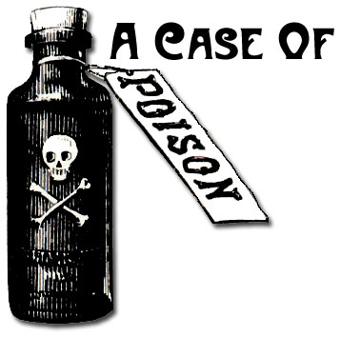
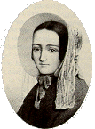
Marie LaFarge
“In 1840, Marie LaFarge was tried for the murder of her husband using arsenic. Mysteriously, although arsenic was available to the killer and was found in the food, none could be found in the body. Orfila was asked by the court to investigate. He discovered that the test used, the Marsh Test, had been performed incorrectly, and that there was in fact arsenic in the body, allowing LaFarge to be found guilty.”

Slide 6
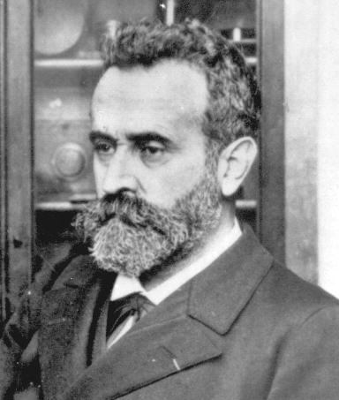
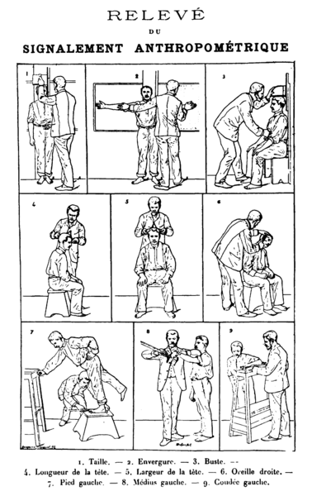
Alphonse Bertillon (1853-1914)
1st scientific system of personal
identification
Anthropometry
(body measurements)
“Father of criminal identification”

Slide 7
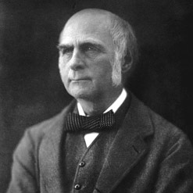
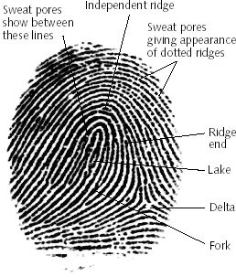
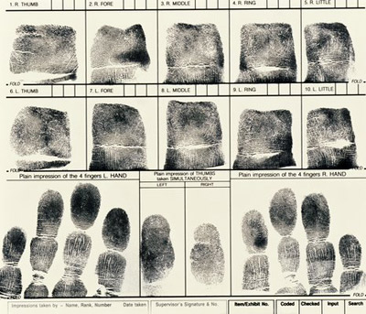
Francis Galton (1822-1911)
1st definitive study of fingerprints and classification
Classification system still in use today

Slide 8
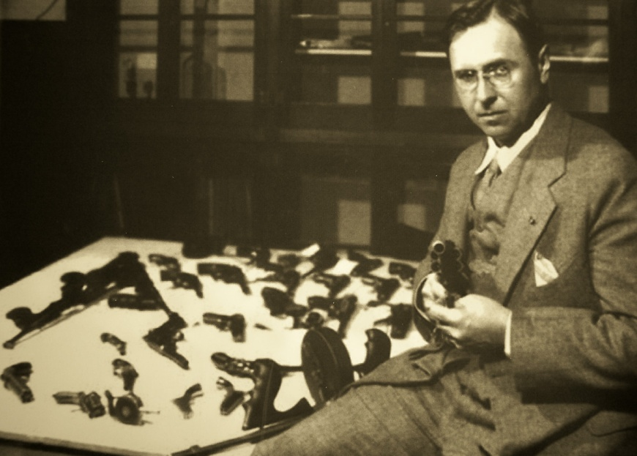
Colonel Calvin Goddard (1891-1955)
Established a crime detection laboratory at Chicago’s Northwestern University in 1929
Perfected the comparison microscope for bullet and cartridge case examinations

Slide 9
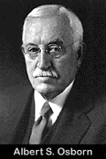
Osborn (1858-1946)
Developed fundamental principles of document analysis

Slide 10
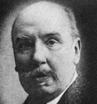
  A magistrate and law professor in Austria
  Known for his publications and for introducing the word “criminalistics”
  In 1893, published a Handbook for Magistrates that greatly influenced the practice of criminal investigations
Hans Gross

Slide 11
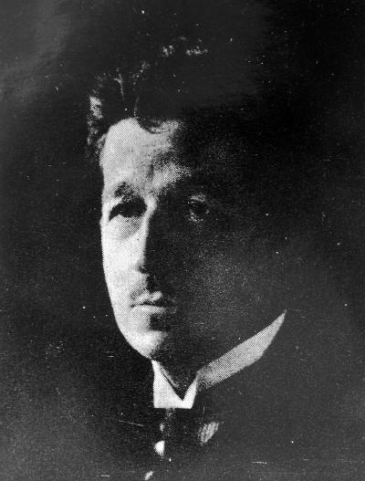
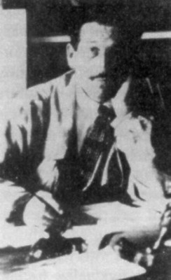
Edmond Locard (1877-1966)
Set up crime labs in France

Slide 12
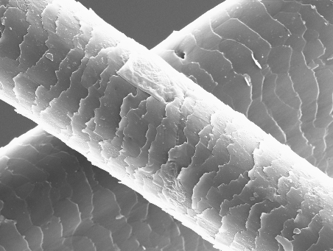
“Every contact leaves a trace”
What does it mean?
When a criminal comes in contact with an object or a person, a cross-transfer of evidence occurs

Slide 13
'Wherever he steps, whatever he touches, whatever he leaves, even unconsciously, will serve as a silent witness against him. Not only his fingerprints or his footprints, but his hair, the fibers from his clothes, the glass he breaks, the tool mark he leaves, the paint he scratches, the blood or semen he deposits or collects. All of these and more, bear mute witness against him. This is evidence that does not forget. It is not confused by the excitement of the moment. It is not absent because human witnesses are. It is factual evidence. Physical evidence cannot be wrong, it cannot perjure itself, it cannot be wholly absent. Only human failure to find it, study and understand it, can diminish its value.’
-Professor Edmond Locard

Slide 14
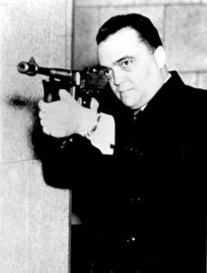
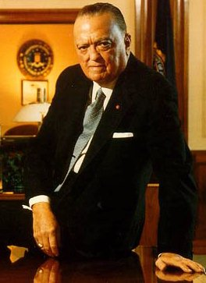
J. Edgar Hoover (1895-1972)
Was head of the FBI
1932- organized a national crime laboratory
Set up forensic services to all parts of United States

Slide 15
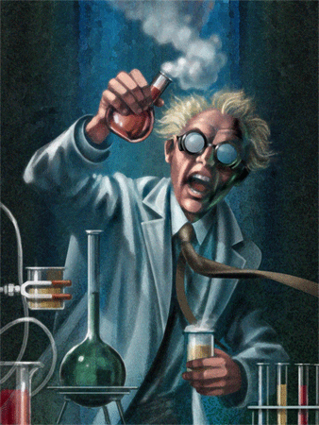
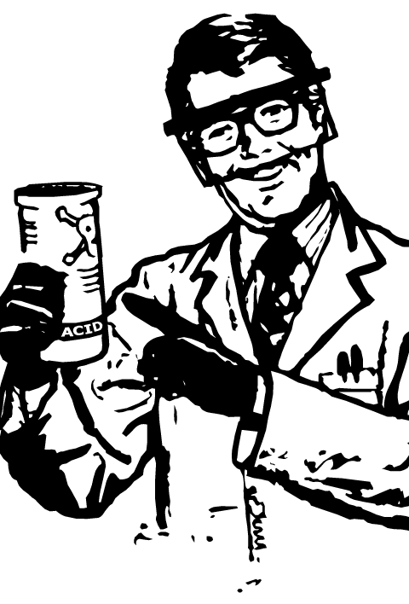
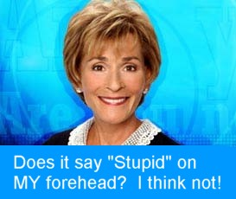
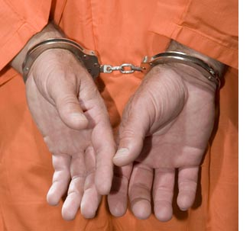
“Forensic Science”
Let’s break down the 2 words
Science –
organized way of using evidence to explain the natural world
Forensics –
refers to legal matters or is related to the courts

Slide 16
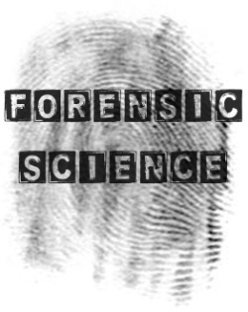


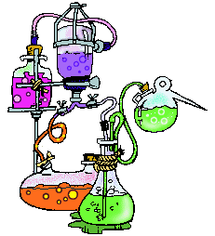


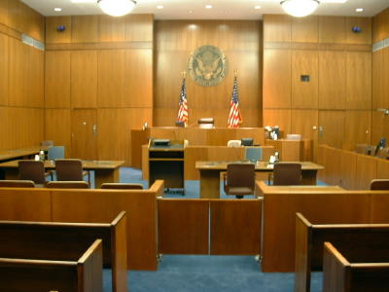
What is forensic science?
Application of a broad spectrum of sciences in regards to the legal system
Legal system includes:
Criminal courts & civil courts
What is the difference?

Slide 17
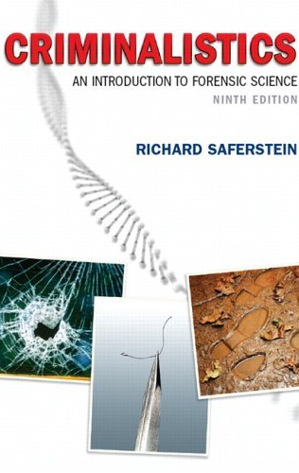
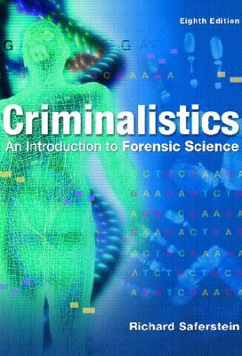
Criminalistics
is just a fancy term for
forensic science

Slide 18
let’s
talk
about
The
reading!

Slide 19
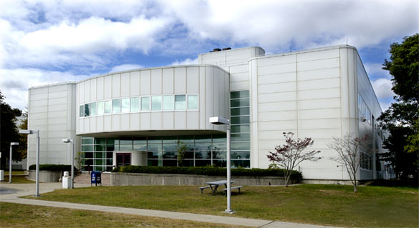
Suffolk County Medical Examiner’s
Office (& Crime Lab)
“The Office of the Suffolk County Medical Examiner is a Division of the Department of Health Services. The 85,000 square foot facility is physically located in Hauppauge in the North County Complex off of Veterans Memorial Highway. The Division is comprised of the Pathology, Toxicology, and Crime Laboratory Sections.” SCME
Yes, we live in Suffolk County
Case load for one day
In Suffolk, there is a chief M.E. and 4 M.E.s

Slide 20
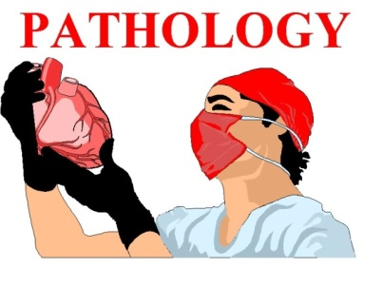
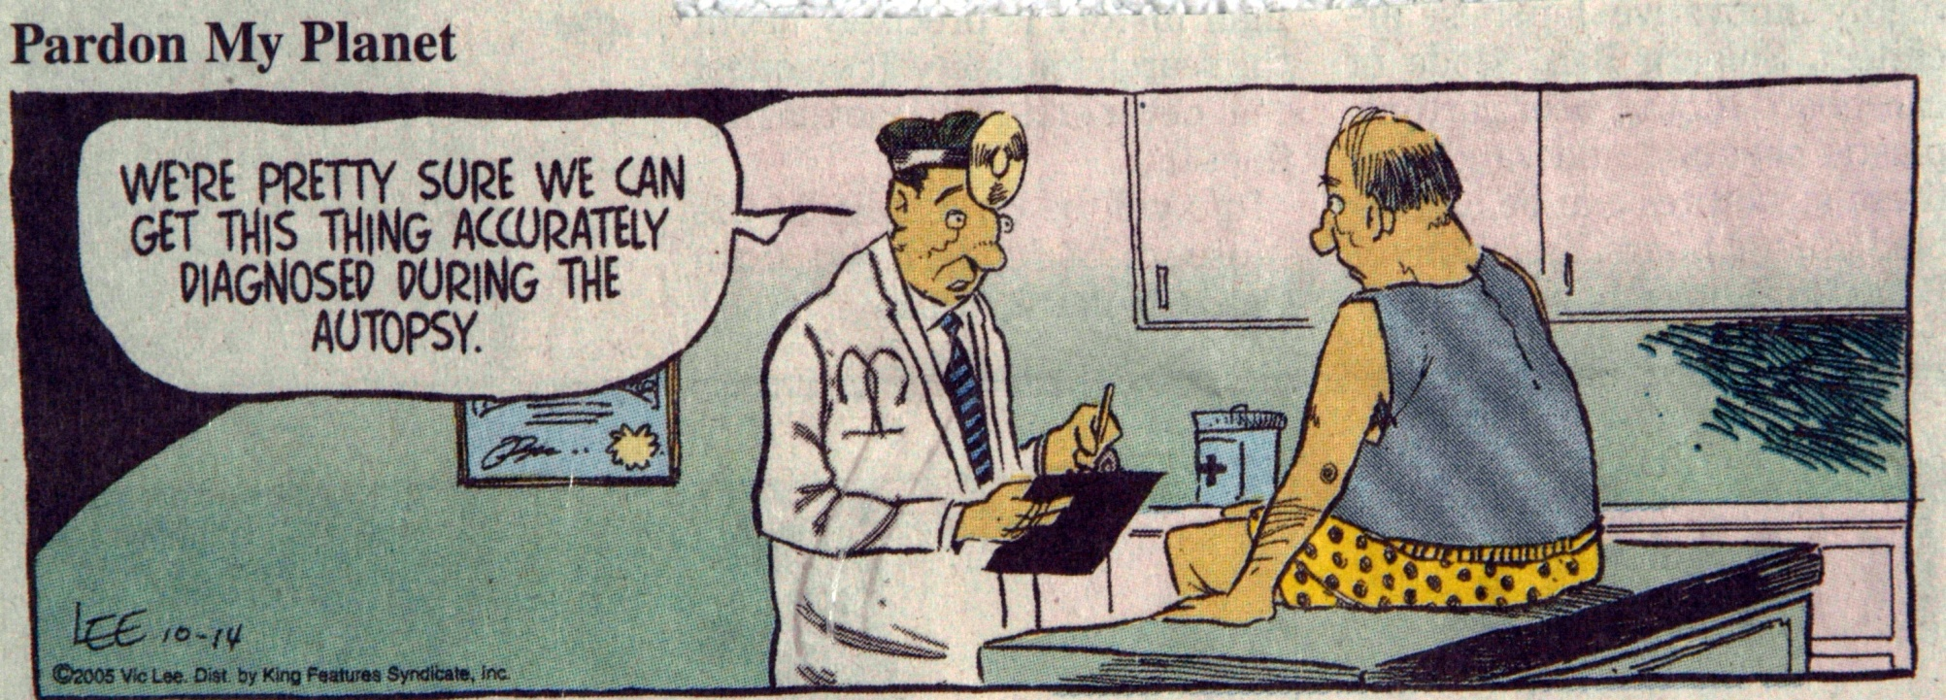
Pathology
The medical specialty that deals with disease and the bodily changes caused by disease

Slide 21
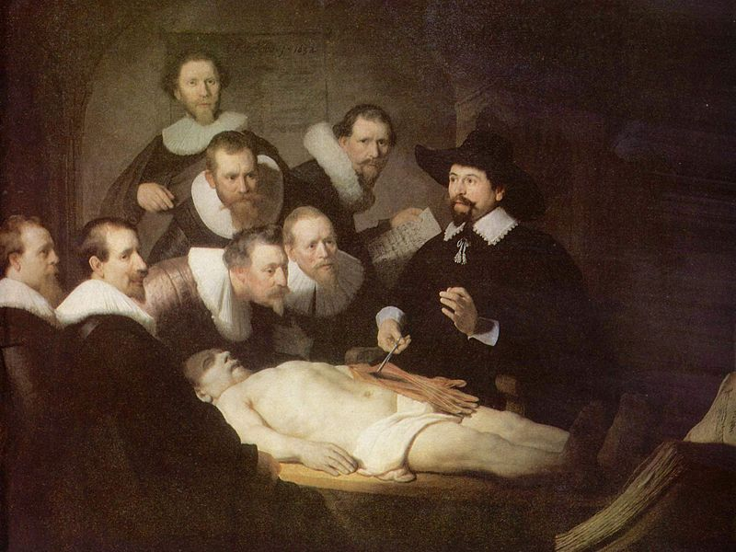
“The Pathology Section investigates about 4500 deaths per year and performs about 900 autopsies per year. The Forensic Medical Investigators are all Registered Physician Assistants, and the Pathologists are fulltime Medical Examiners.” SCME

Slide 22
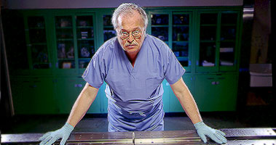
Medical
Examiner
Who is this
M.E.?
Is a licensed physician
  Graduation from medical school
  Completion of residency in pathology
  Fellowship in forensic pathology
“The above training requires about 9 years to finish. For example, if you graduate with an undergraduate degree at 22, you should be finishing the above training by age 31.” Collin

Slide 23
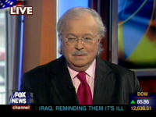
PEOPLE IN THE NEWS
He has been involved as an expert in forensic pathology in many cases of international interest including:
  The remains of Tsar Nicholas of Russia and his family
  The Claus Von Bulow murder trial
  Expert witness for the defense in the O.J. Simpson trial
  Re-autopsy of Medgar Evers, Civil Rights leader
  Re-examination of the Lindberg Kidnapping and murder
  Autopsies of the victims of TWA Flight 800
Dr. Baden is the host of HBO’s Autopsy series and is featured on many of the crime talk shows.
Dr. Michael M. Baden is a renowned pathologist and was the Chief Medical Examiner in NY City and for Suffolk County.
Dr. Baden was on the panel that investigated the assassinations of president John F. Kennedy and Dr. Martin Luther King, Jr.

Slide 24
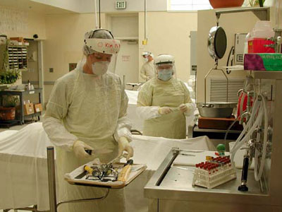
Functions of the M.E.
1)
Time of Death
(Body temperature, stomach contents, insects)
2)
Cause of Death
(gunshot, broken neck, poisoning, disease, etc.)
3)
Manner of Death
(Homicide, suicide, accidental, natural)

Slide 25
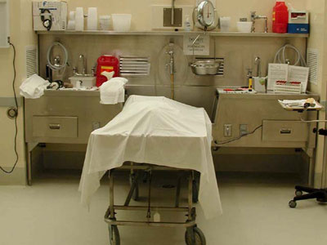
Reportable Cases
All
Sudden
Deaths!
“By law, the Medical Examiner must be notified of any death which occurs suddenly and unexpectedly while the victim is in apparent good health, or whenever there is a suspicion that the death may be unnatural. Also reportable are deaths which occur in the workplace, and cases of public health interest (e.g. suspected but undiagnosed possible tuberculosis, meningococcemia, anthrax, tuleremia, etc.).” SCME

Slide 26
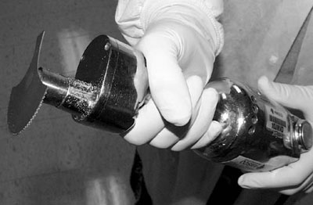
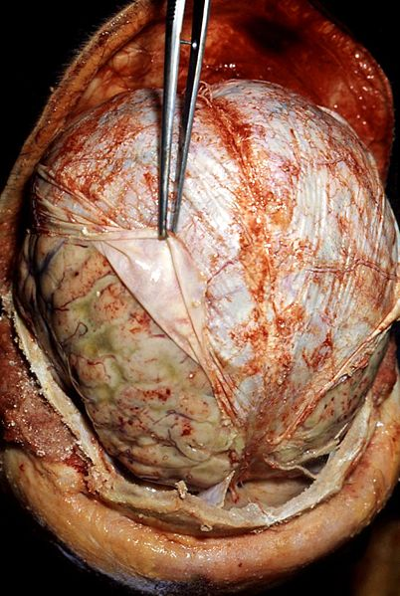
What might this be used for?

Slide 27
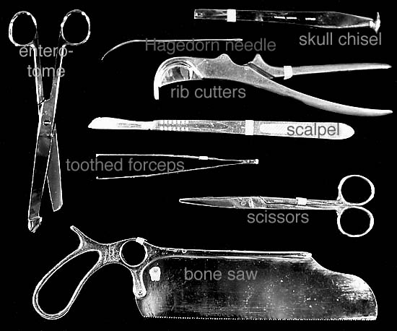
TOO
L
S
O
F
THE
TRADE

Slide 28
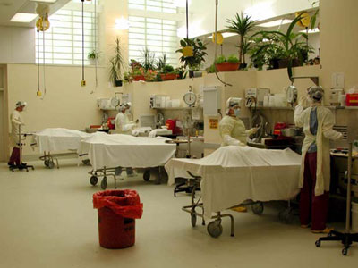
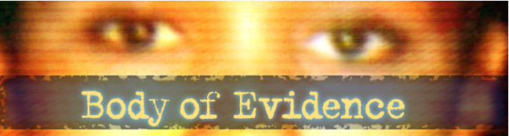
Autopsy
Dead body is now a piece of evidence
M.E. examines the body externally and internally (usually 1 to 1.5 hours)

Slide 29
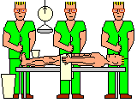

Slide 30
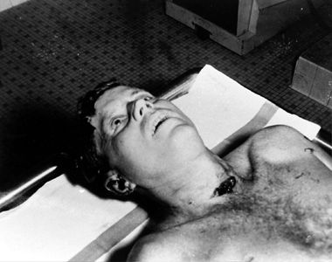

Slide 31
10 myths about the medical examiner’s office (courtesy of S.C. Chief Medical Examiner)
1) Medical examiner is a coroner
2) All deaths in Suffolk are reported
3) Only violent deaths are investigated
4) All bodies that come in are autopsied
(4,537-→1,000)
5) Each medical examiner gets assigned 1
body per week

Slide 32
10 myths about the medical examiner’s office (courtesy of S.C. Chief Medical Examiner)
6) Each medical examiner has 1 assistant
7) Our “patients” do not talk to us
8) Examination of the body tells you
everything you need to know
9) Autopsy interferes with viewing at the
wake and will cause a delay
10) M.E.s are emotionally imbalanced,
demoralized, and depressed a lot

Slide 33
Coroner vs. Medical Examiner
Coroner -
Elected official
May not have medical background
Can call on a specialist
Medical Examiner-
Specialist (Licensed Pathologist)
Appointed

Slide 34


Forensic Science Specialties
Forensic Pathology:
Pathology is a specialty area of medicine
Pathology is the study of diseases and the bodily changes caused by the diseases
Forensic pathologists determine the cause of death (the medical reason why a person died; e.g.
asphyxiation)
Forensic pathologists determine the manner of death (the circum-
stances causing death; e.g. homicide)

Slide 35

Forensic Science Specialties
Forensic Entomology:
  Entomology is a branch of biology devoted to the study of insects
  Forensic entomologists use insects as investigative aids
  By examining insects, larvae or pupae associated with a corpse, knowing the life cycle of insects, and by using the existing environmental factors, forensic entomologists can estimate the time of death

Slide 36


Slide 37

Forensic Science Specialties
Forensic Odontology:
Odontology is the study of the physiology, anatomy, and pathology of teeth
Forensic odontologists perform two types of analyses involving the human dentition
  Identify human remains by comparing premortem and postmortem dental X-rays
  Bite mark comparisons (crime scene marks to known bite marks)

Slide 38

PLEASE BRUSH YOUR TEETH

Slide 39

Forensic Science Specialties
Forensic Anthropology:
Anthropology is the science of the human skeleton and how it has evolved over time

Slide 40

Forensic Science Specialties
Forensic Toxicology:
Forensic toxicology is the study of the effects of extraneous materials such as poisons and drugs in the body
Forensic toxicologists must determine both the presence and the amounts of extraneous materials in the body
Assist the medical examiners in determining the cause of death
May be involved in the determination of ethanol levels in blood and breath samples

Slide 41


Forensic Science Specialties
Forensic Serology
- analysis of bodily fluids
Fingerprints
-analysis of friction ridge patterns

Slide 42

Forensic Science Specialties
Firearms Analysis
-gun & bullet
comparisons,
GSR
Do you want to see chicks with guns?

Slide 43


Slide 44

OH NO!
PETE IS THAT YOU?

Slide 45


Forensic Science Specialties
Questioned Documents
-investigations into
the authenticity
of documents

Slide 46


Forensic Science Specialties
Forensic Computer Science:
Use information located on computers and other electronic devices as investigative aids
Find hidden or deleted information to determine if internet based crimes have been committed

